Slide 1
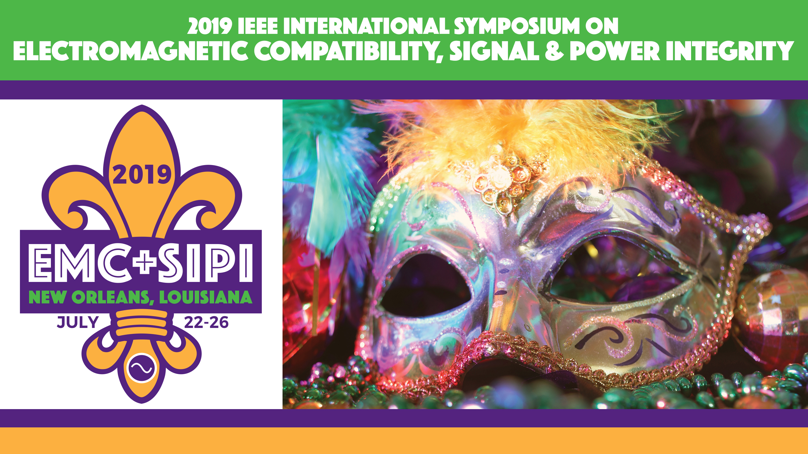

Slide 2
Chicago Chapter 2018-2019
9 Chapter meetings
  September Louann Mlekodaj Shure, Inc.
  October Dan Perkins Rohde and Schwarz ELITE OKTOBERFEST w/SAE
  November Steve Murphy LeCroy-Teledyne
  December Holiday Party
  February Stan Mlekodaj U.S. Cellular
  March Jim Rader Harley Davidson ELITE St. Patrick's Day Event
  April Joanna McLellen EMC Productivity
  May 22nd Annual Mini Symposium Eric Bogatin
  June Corey Bradshaw DLS DLS Summer Cook Out w/VTS

Slide 3
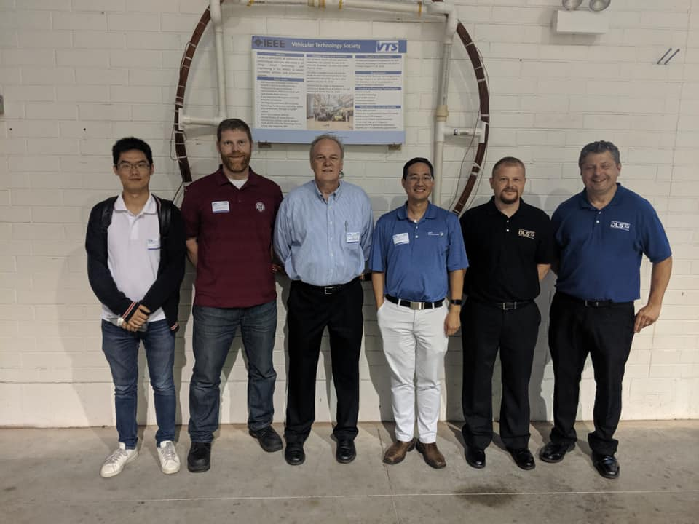
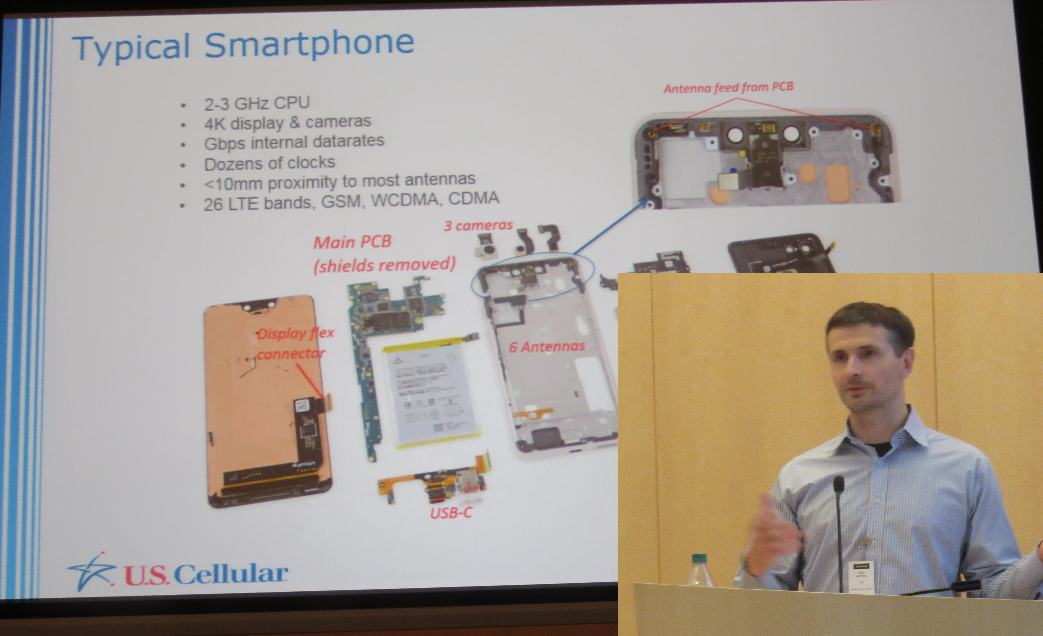

Slide 4
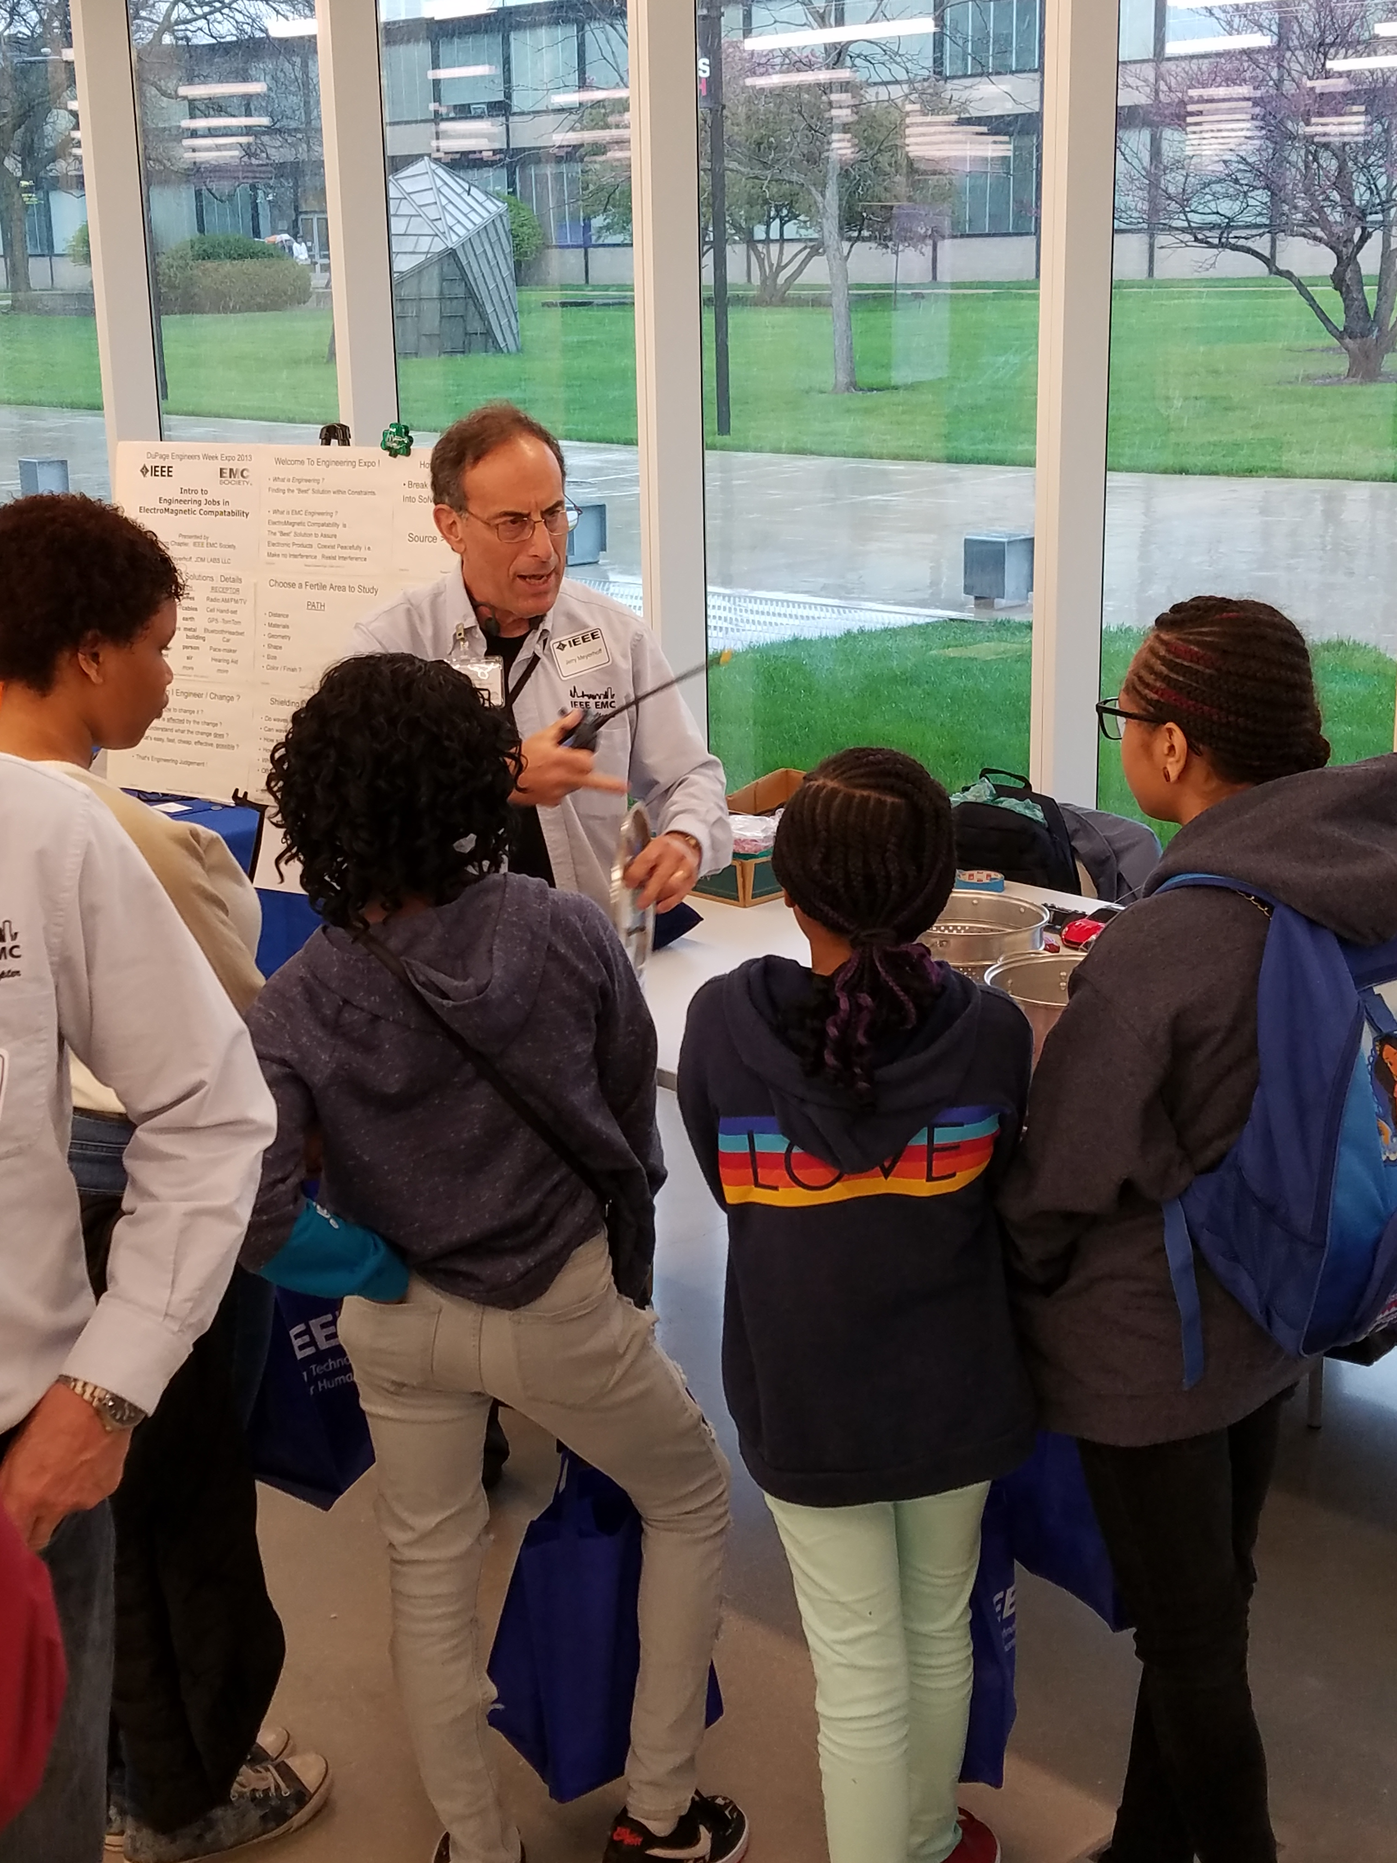
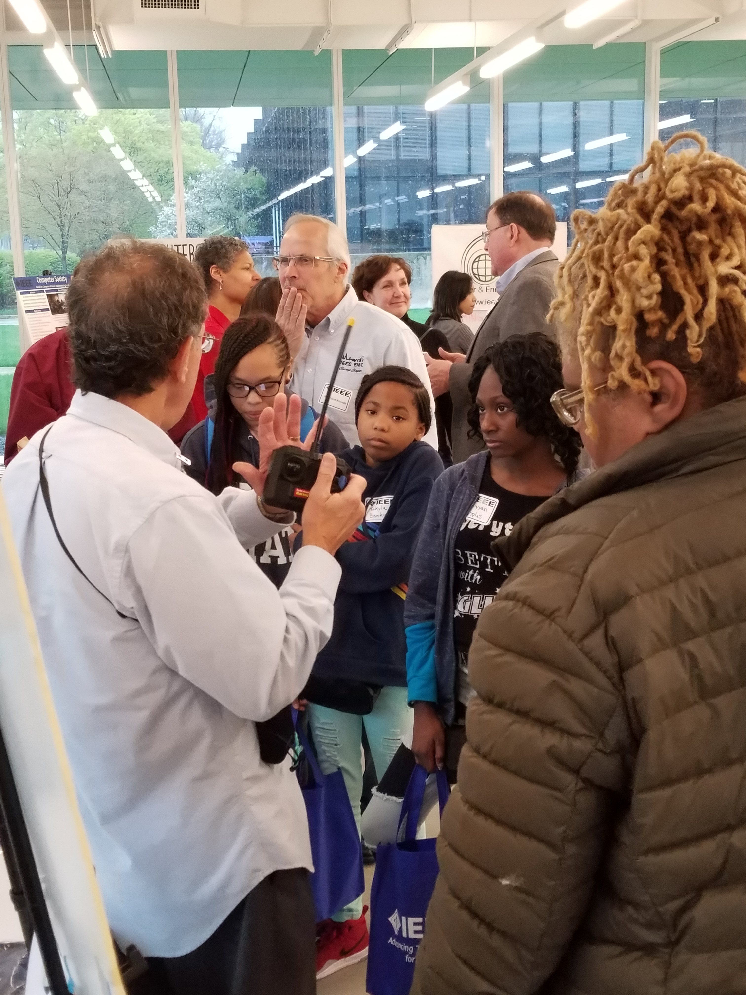
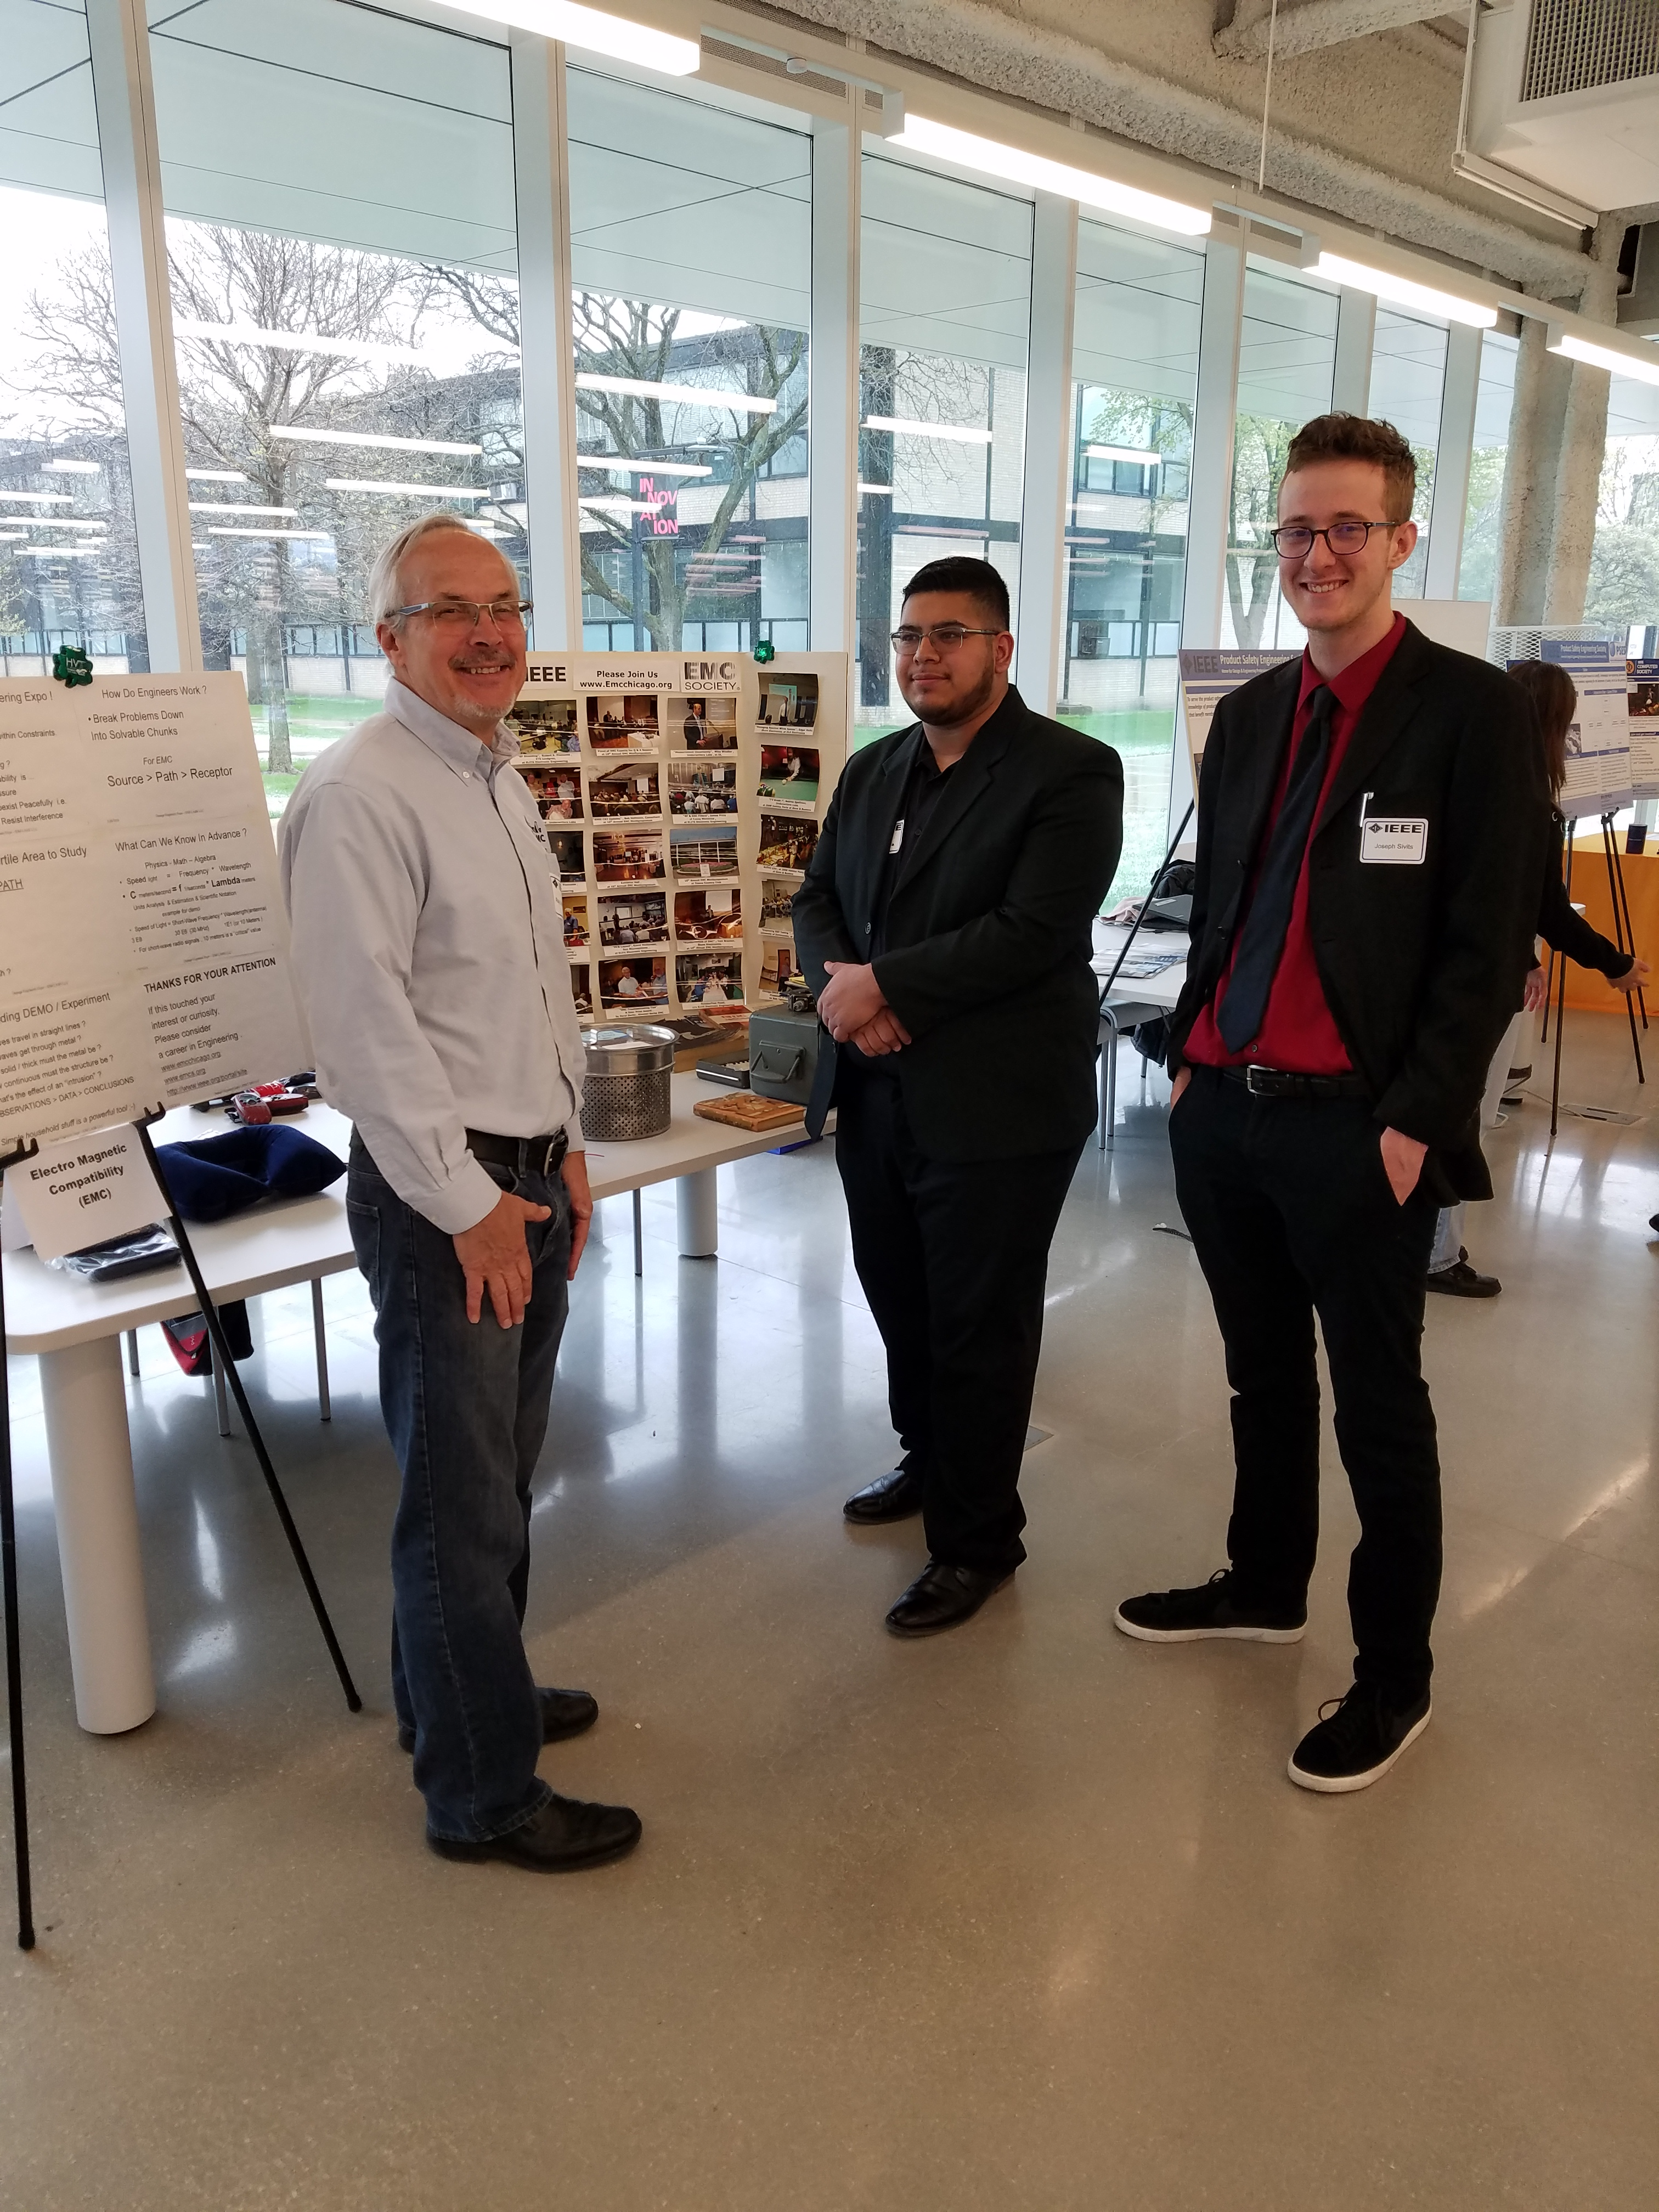
Chicago Chapter 2018-2019 Additional Events
125th Anniversary Conference IEEE Chicago Section

Slide 5
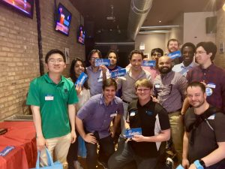
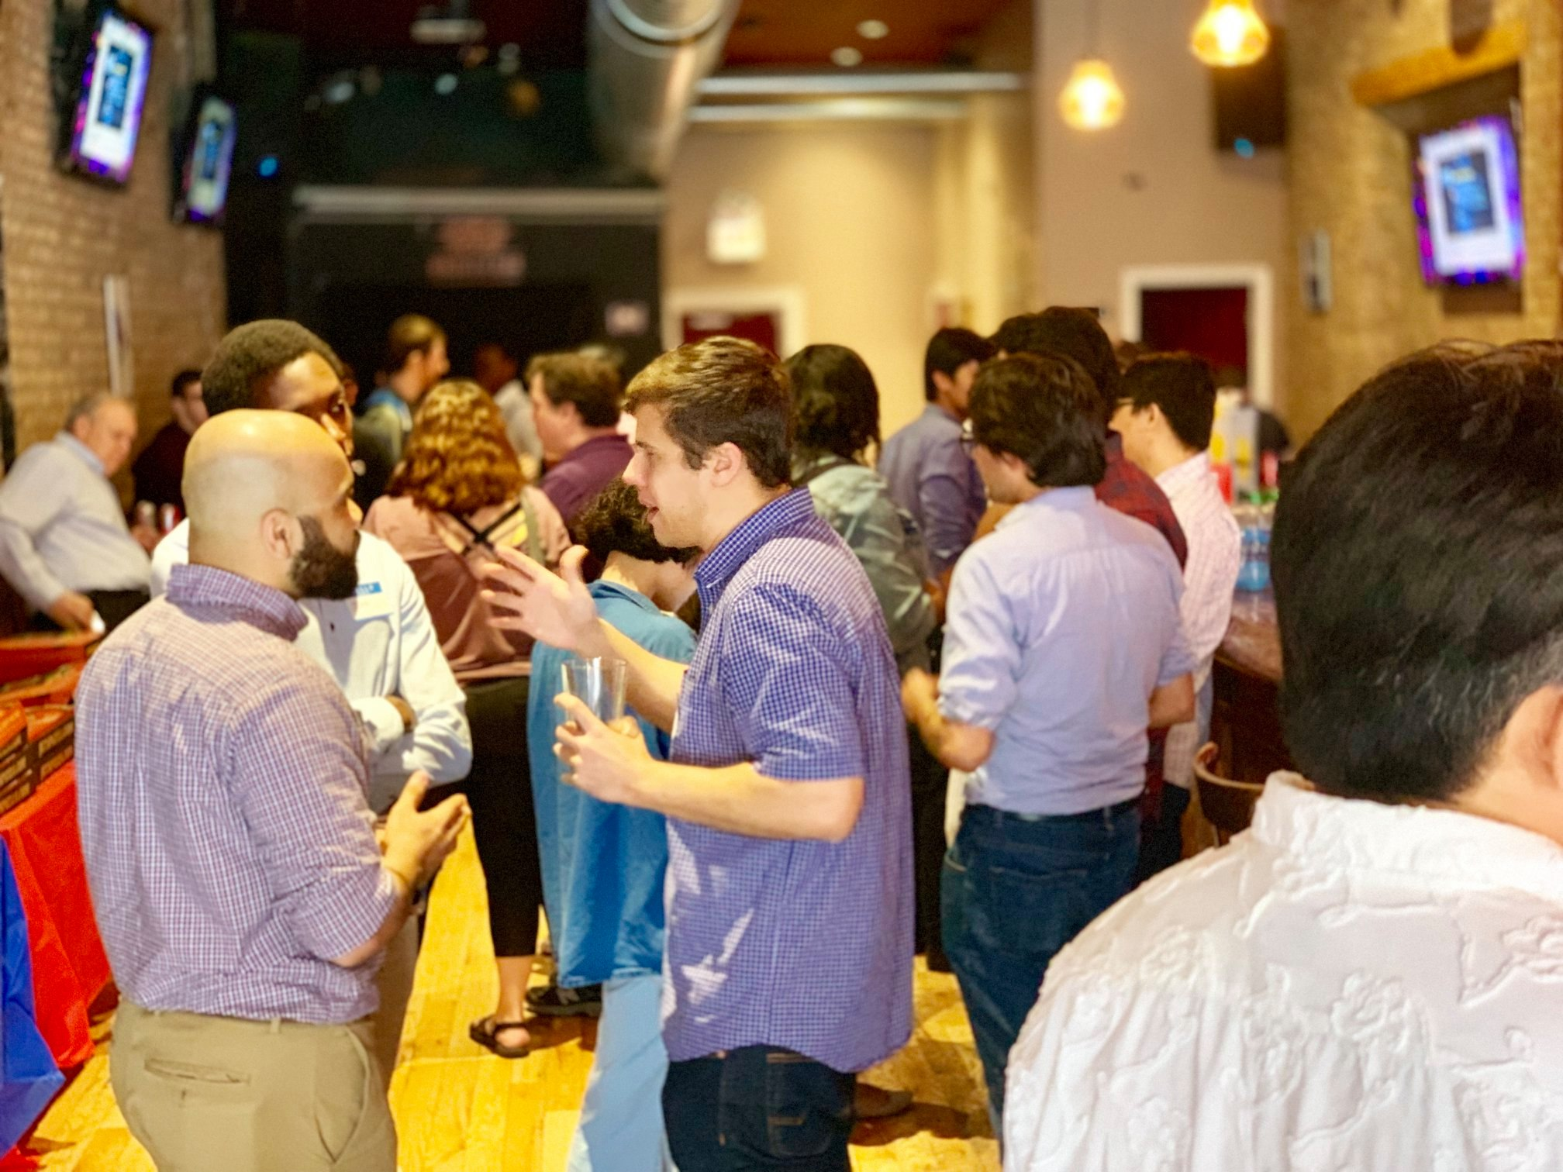
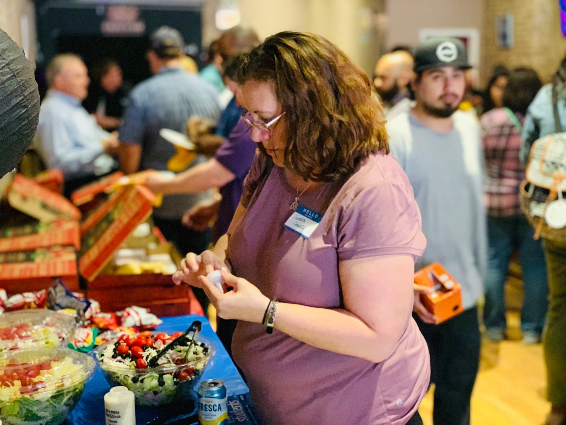
Chicago Chapter 2018-2019 Additional Events
IEEE Region 4 Student Activities Mixer

Slide 6
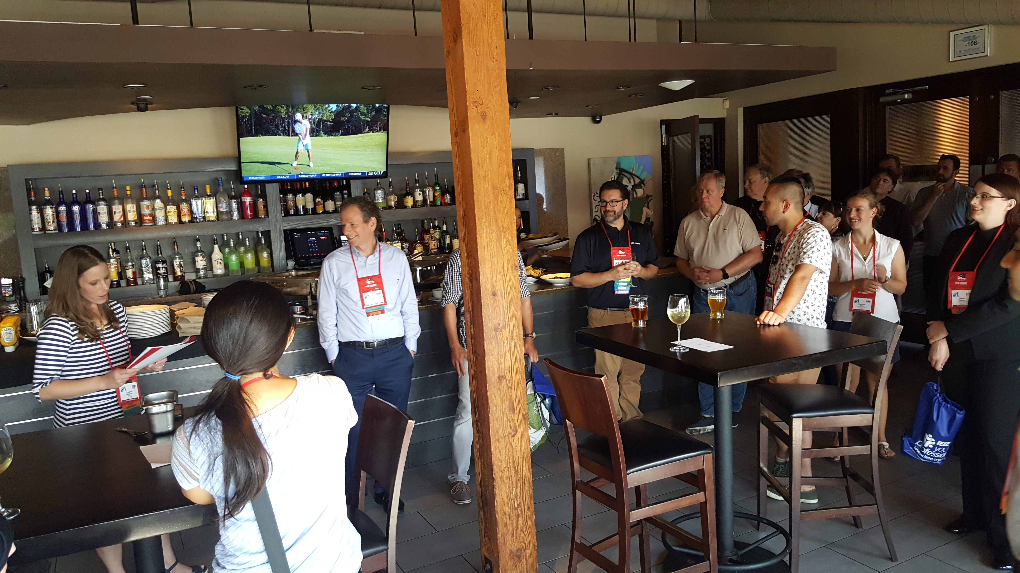
Chicago Chapter 2018-2019 Additional Events
YP EMC Event in New Orleans: TONITE Chicago Chapter is a Sponsor
  Monday EMC Jeopardy and Networking at:
  The District, 711 Tchoupitoulas St., New Orleans, LA
  13 sponsors are providing financial support to the YP events
    There monies will provide financial support for the 2 events and T-shirts
    The Experts that part of the Monday night event along with the companies, will foster helping the young engineers in the EM community find a place in the larger EM community.

Slide 7
Chicago Chapter 2018-2019 Additional Events
YP EEMC YP Networking Event: Wednesday, July 24, 2019 • 9:00 to 11:00pm
The Rusty Nail, 1100 Constance St, New Orleans, LA
Price: $15 (includes one drink and small appetizer/dessert)
Get to know your fellow Young Professionals in a casual setting after the Evening Gala. This is a great time to continue the conversations started during the Gala or to introduce your friends. Relationships formed in the EMC Society can lead to future collaborations on projects and will provide valuable contacts when you need a friend to bounce ideas off.

